Slide 1
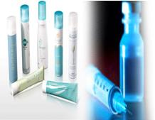
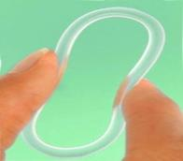
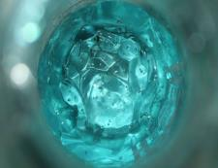
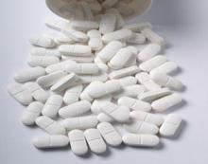
Luteal phase support – an update
Marina Šprem Goldštajn, Assist prof.
Department for gynecology and Obstetrics
Medical School University of Zagreb

Slide 2
Reproduction is Controlled by the Hypothalamus-Pituitary-Ovarian (HPO) Axis
-
Hypothalamus
Negative
feedback
Positive
feedback
GnRH
GnRH stimulates release of FSH and LH from the pituitary
FSH and LH act on the ovaries where they stimulate
  Follicular development
  Estradiol secretion
Rising estradiol levels activate positive feedback on pituitary
  Pre-ovulatory gonadotropin surge
Ovulation
++
Pituitary
Estradiol
LH
FSH
Ovaries
Estradiol
Progesterone
Hall J. Yen and Jaffe’s Reproductive Endocrinology: Physiology, Pathophysiology, and Clinical Management. 6th ed. Philadelphia, PA: Saunders Elsevier; 2009:139-154.
GnRH: Gonadotropin-releasing hormone, LH: Luteinizing hormone, FSH: Follicle-stimulating hormone.

Slide 3
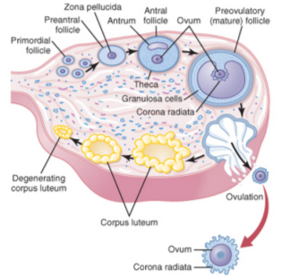
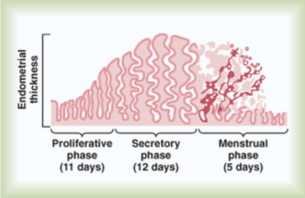
The Corpus Luteum Secretes Progesterone, Preparing the Endometrium for Implantation
After ovulation, the corpus luteum secretes large quantities of
  Estrogen¹
    Increases the number of ciliated epithelial cells lining the fallopian tubes
    Slightly increases cellular proliferation in the endometrium
  Progesterone¹
    Causes marked swelling and secretory development of the endometrium
Endometrium reaches a peak thickness of 10-14 mm²
1. Guyton AC, Hall JE, eds. Textbook of Medical Physiology. 11th ed. 2006. 2. Fritz MA, Speroff L, eds. Clinical Gynecologic Endocrinology and Infertility. 8th ed. 2011.

Slide 4
ART Involves the Direct Manipulation of Oocytes Outside the Body
In vitro fertilization (IVF) is the primary method of ART
IVF is a multi-step process
Controlled ovarian stimulation
Oocyte retrieval and maturation*
Fertilization
Assessment of embryos
(Day 3 or 5)*
Embryo transfer
Implantation assessment
Pregnancy monitoring
*Extra oocytes or embryos may be cryopreserved for future use.
ASRM. Assisted Reproductive Technologies: A guide for patients. Available at: http://www.asrm.org/uploadedFiles/ASRM_Content/Resources/ Patient_Resources/Fact_Sheets_and_Info_Booklets/ART.pdf. Accessed on December 16, 2011.

Slide 5
Controlled Ovarian Stimulation is Used to Stimulate the Growth of Multiple Follicles
Follicle development
Follicle maturation
GnRH agonists
FSH/LH
or
hCG
GnRH antagonists
FSH/LH
Oocyte retrieval
GnRH agonists and antagonists prevent a pre-ovulatory LH surge¹
Gonadotropins induce the growth of multiple follicles until 1-2 follicles are ≥17 mm ^{1,2}
hCG promotes final maturation of the follicles¹
Oocytes are retrieved 36-40 hours after hCG administration (before ovulation)²
1. Macklon NS and Fauser BCJM. Yen and Jaffe’s Reproductive Endocrinology: Physiology, Pathophysiology, and Clinical Management. 6th ed. Philadelphia, PA: Saunders Elsevier; 2009:689-724. 2. Fritz MA, Speroff L, eds. Clinical Gynecologic Endocrinology and Infertility. 8th ed. 2011.

Slide 6
Luteal Supplementation is Necessary for a Successful Pregnancy
Follicle development
Follicle maturation
Luteal support
GnRH agonists
FSH/LH
or
Progesterone
hCG
GnRH antagonists
FSH/LH
Oocyte retrieval
Embryo transfer
Prolonged GnRH results in a corpus luteum unresponsive to hCG
The day after oocyte retrieval, progesterone or hCG is given for luteal support
  hCG increases the risk of ovarian hyperstimulation syndrome (OHSS)
Day 3 or Day 5 embryo(s) are transferred
Pregnancy test performed 14 days after oocyte retrieval
Smitz J, et al. Hum Reprod. 1992; 7(9):1225-1229.

Slide 7
Proposed causes of LPD
Granulosa cells removal during oocyte retrieval
Aspiration of preovulatory oocyte in natural cycles did not cause an apparent LPD
HCG induced supression of LH
HCG injection supresses endogenous LH production
HCG injection did not downregulate LH secretion in the lutral phase of natural cycles in ovulatin women
GnRH agonist induced pituitary supression
Delay in pituitary recovery from supression by GnRH agonists
LPD presents despite rapid pituitary recovery with GnRH atagonists
Sex steroid supression of LH
Supraphysiologic concentration of sex steroids secreted by multiple corpora lutea during the early luteal phase which directly inhibits LH release by negative feedback to the pituitary and hypothalamus

Slide 8
Importance of Progesterone in ART
Because GnRH suppresses the function of the corpus luteum, progesterone is required for luteal-phase support
  Luteal supplementation: widely recommended for non-donor cycles (some endogenous progesterone production)
  Luteal phase replacement: required for donor egg cycles (no endogenous progesterone production)
Available in intramuscular, oral, and vaginal (gel and insert) formulations
Usually prescribed through 12 weeks of gestation
All current formulations require dosing at least daily
Progesterone vaginal ring is dosed weekly
van der Linden M, et al. Cochrane Database Syst Rev. 2011; (10):CD009154.

Slide 9
Advantages of Vaginal Drug Delivery
Avoids hepatic first-pass metabolism
  Lower doses
  Avoids gastrointestinal interference with absorption
Continuous release with constant serum levels
  Improved side effect profiles compared with oral therapies
  Local vs. systemic effects
Less frequent dosing (weekly dosing)
User-controlled, discreet
  High patient satisfaction
Alexander NJ, et al. Fertil Steril. 2004;82:1-12.
Notes:
9

Slide 10

lps has a significant impact perspectives

Slide 11

Perspectives on LPS
Although LPS is at the tail-end of the IVF process, women still experience a high level of anxiety, stress and anticipation during this time
“Once you're pregnant, you want to do everything you can to stay pregnant and be healthy. Getting pregnant is only one step in the process. Staying pregnant is another whole deal.” – Alice
Although a small part of the process, LPS can have a significant impact

Slide 12
Perspectives on current progesterone options
Current LPS delivery has its short-comings; from the pain of intramuscular injections, to the messiness and worry associated with gels and suppositories, to systemic concerns with pills
“Those progesterone shots are just cruel…the needles are huge and they hurt. And with the suppositories, I literally could feel the stuff running out of me, and that’ll make you nervous.” – Kristy
“People don't like taking pills…it just seems weird…unnatural maybe. It's a natural hormone. It just seems unnatural to be in a pill form.” – Neshanta
Can contribute to physical and emotional stress already experienced during IVF

Slide 13
Perspectives on current progesterone options
While delivery may seem relatively easy, numerous factors make the appropriate utilization of these products a challenge
“I was traveling and nervous because my flight got delayed …They were talking about stopping at some other airport, and I’m like, ‘I’m out of my progesterone medication!’ so I was freaking out…I remember trying to pack it with ice packs in my suitcase…I had trouble at the hotel even storing them because the hotel I was booked into didn’t have a refrigerator.” – Kristy
“Shots weren’t fun …nobody can get used to shots, ‘aww I have to do this again tonight’ emotionally, it was very irritating …having that reminder that they needed to be done, was just too much” –Pamela
Current options don’t accommodate for the variability of daily life

Slide 14

Perspectives on intramuscular injections (IM)
Aside from the physical pain of injecting IM progesterone, the tedious, complicated nature of delivery often requires dependence on a spouse/partner, which can generate additional stressors
“I know he's doing his best but he is not a doctor or a nurse and it is rough…one day it may be good, I may not really feel much. The next day it's like I'm being butchered…it's awful. “– Neshanta
“My husband wasn’t careful at all. Every time I took the shot, it was an emotional ride. Every day it was disappointing to me” – Pamela
While they recognize and appreciate the involvement, it can take a toll on relationships

Slide 15

Perspectives on gels and suppositories
Most women were familiar with gels and suppositories and from their experience with them (as well as in other categories), find a high “ick factor with using these products
“The stuff turns into like a gooey, oily mess immediately.” – Kristy
“Although I had never used the suppositories, I had for yeast infections, and so I knew they were messy.” – Kelly
While less disruptive than IM injections, gels/suppositories don’t garner strong advocates

Slide 16
Perspectives on gels and suppositories
In addition to the messiness, women are also concerned about leakage of medication and whether they are truly getting the progesterone they need to sustain their pregnancy
I was very stressed…some [cycles] didn't work, and I didn't know, "Was it my fault because I didn't do it correctly? Because the gel didn't come out? Did I do too much one day? And then my progesterone level spiked and then it dropped because I did one the next day?“– Jennifer
“I was always wondering…am I actually absorbing enough of it because the stuff you have to wear, panty-liners and whatnot.” – Kristy
“The way I visualized …the concept of when the progesterone suppository does melt with your body heat, I had always this fear that you're losing a lot of it drains out.” – Kelly
Variability in technique and frequency of use can be worrisome

Slide 17

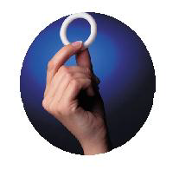
vaginal progesterone ring – A MORE Positive progesterone experience
progesterone vaginal ring for which the proposed indication is to support embryo implantation and early pregnancy (up to 10 weeks post-embryo transfer)
release rate of 11 mg/day of progesterone
small white ring with dimensions of 36 mm (internal diameter) x 54 mm (external diameter) x 9 mm (cross-sectional diameter)

Slide 18

First impressions of P4 ring
When first exposed to P4 ring, women recollect being taken aback by the size, especially those familiar with rings
“It was a little bigger than I expected.”
– Laura
“I was pretty shocked how big it was …I’m supposed to insert this inside of me?” – Pamela
I think first thing, you’re kind of like ‘wow, is this going to be hard to get in? Is it going to be tricky?’” – Kristy
P4 ring size needs to be proactively addressed to counter any anxiety around trial

Slide 19
Experience using P4 ring
When women have had an opportunity to use the ring, they are comfortable with it
“Once I went through it a couple times, I really had no problems with it.”
– Laura
“I just felt like it was almost identical to the Ring, really comfortable and no pain or anything like that afterward.” – Kelly
“It was not a big deal, I put it in and couldn’t feel it.” – Pamela
“You just know it's doing its job. You don't have to think about it.” – Jennifer
Convenience and ease are primary functional benefits of P4 ring

Slide 20
Experience using P4 ring
P4 ring alleviates some of the worry associated with getting the right amount of progesterone to support pregnancy
“It just helped me relax. Once the transfer was over ... I didn't have to worry, didn't have to think about, "What do I need to do, and do I need to do it at a certain time?", like all the other medications and stuff that I had to do leading up to it. – Jennifer
“I just think physically and mentally that would have just been much less nerve-wracking to carry something with me and remember when to take it and then having the ring just be, you know, get up and go.” – Kelly
P4 ring overcomes administration-related efficacy concerns

Slide 21

Satisfaction with P4 ring
Women agree that they would use P4 ring for future IVF procedures and are enthusiastic in recommending it to their friends and family
“Doing IVF with the ring was definitely better than doing IVF with the injections. If we ever needed to do IVF again, we would request the ring.”
– Alice
“It would definitely be the first choice to try, in my opinion.” – Jennifer
The P4 ring experience has the potential to garner strong consumer advocates

Slide 22
Study design for the pharmacokinetic study.

Slide 23
Key Points from the Pharmacokinetic Study
Steady-state plasma concentrations of progesterone were reached shortly after the first vaginal ring insertion.
No accumulation of progesterone was observed following administration of the second vaginal ring.
The initial safety profile suggested that the progesterone vaginal ring was safe, thus, phase 2 studies were conducted moving forward.

Slide 24
Study design for the phase 2
Follow-up study

Slide 25
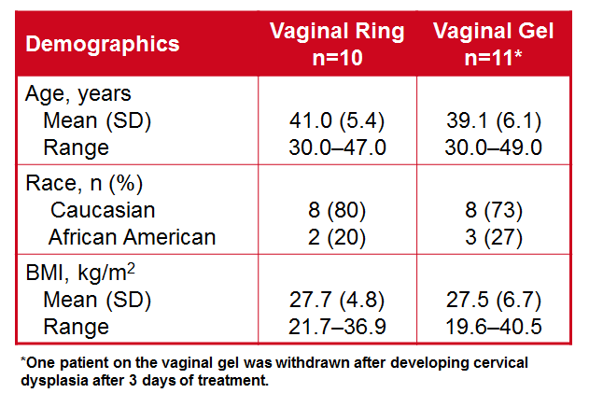
Patient demographics

Slide 26
Serum estradiol and progesterone levels.

Slide 27
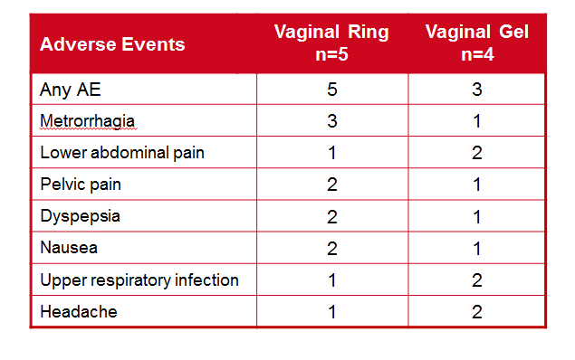
Adverse events.

Slide 28
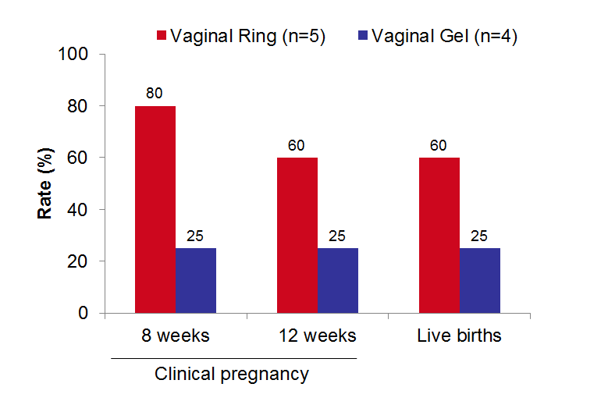
Embryo Transfer Cycle Data
The clinical pregnancy and live birth rates.

Slide 29
Key Points from Phase 2 Studies
The progesterone vaginal ring and gel adequately prepared the endometrium for pregnancy.
The majority of women in the vaginal ring group became pregnant compared with only a quarter of women in the vaginal gel group.
The progesterone vaginal ring was shown to be as safe and effective as a progesterone vaginal gel approved for luteal support during ART.

Slide 30
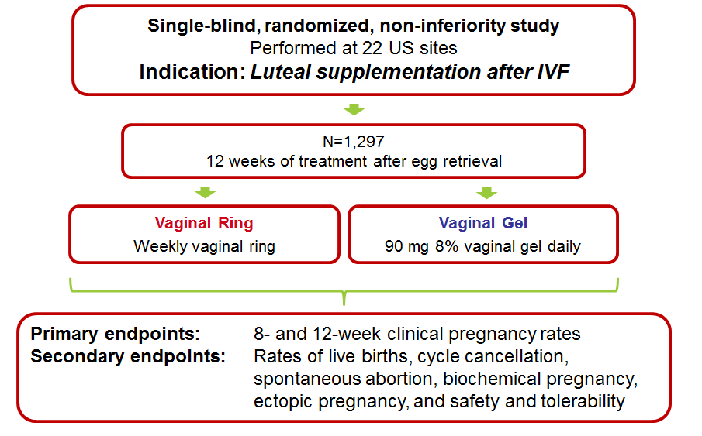
Phase 3 Study

Slide 31
The sequence of study events.

Slide 32
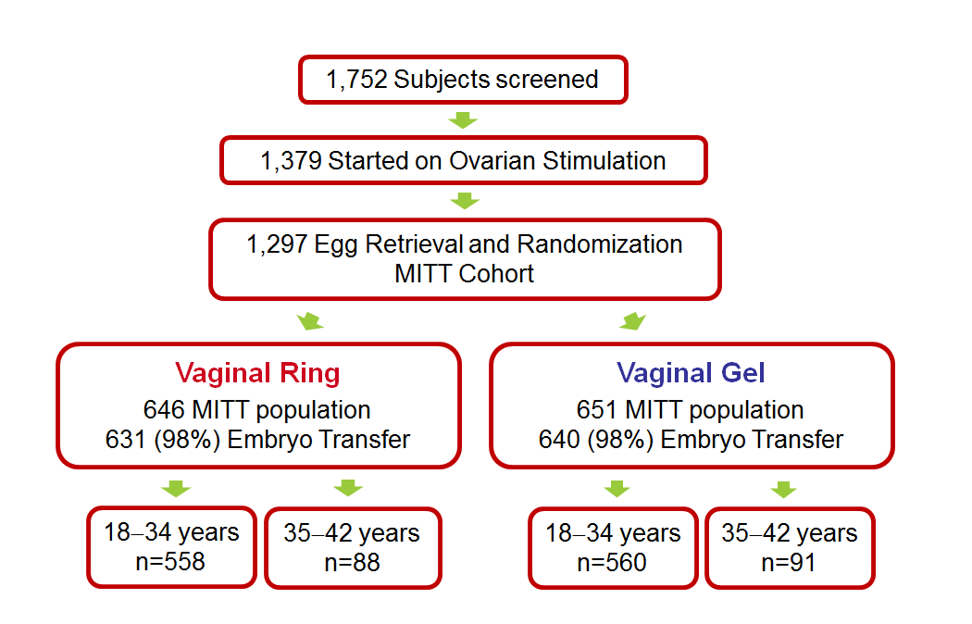
The disposition of subjects.

Slide 33
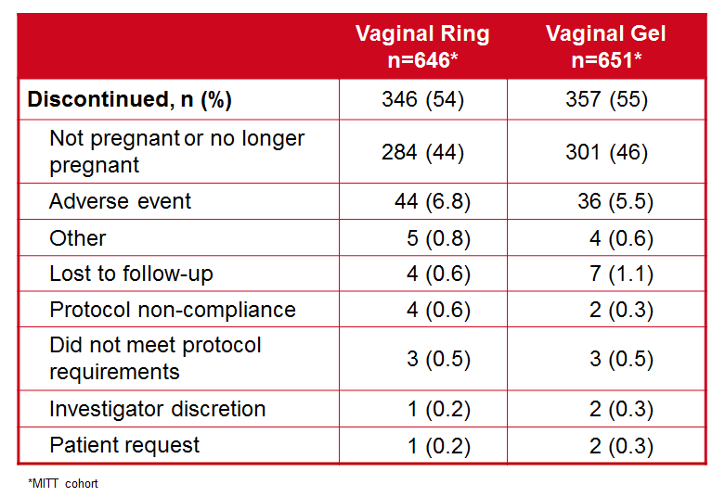
Reasons for study discontinuations.

Slide 34
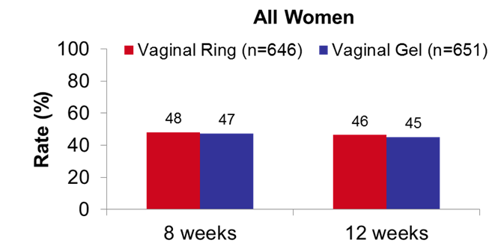
Clinical pregnancy rates for all women (aged 18–42).

Slide 35
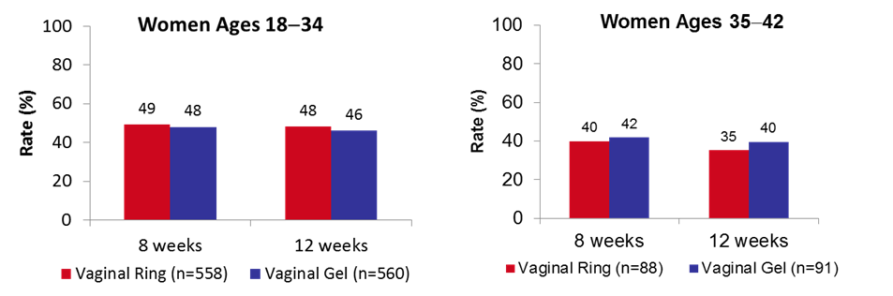
Clinical pregnancy rates for women aged 18–34 and 35–42.

Slide 36
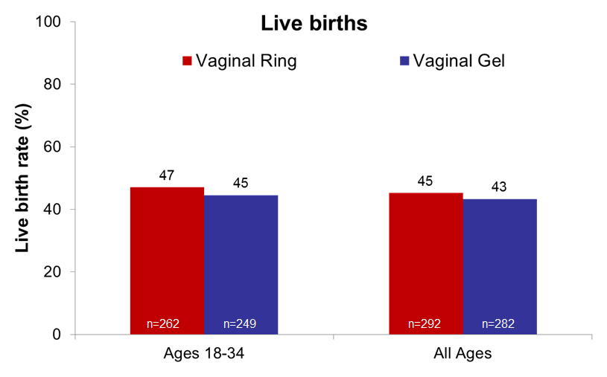
Live birth rates

Slide 37
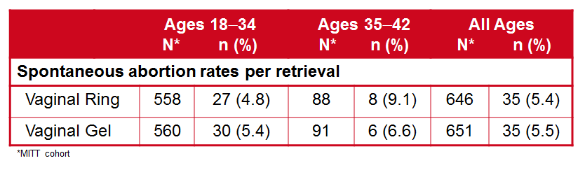
Spontaneous abortion rates

Slide 38
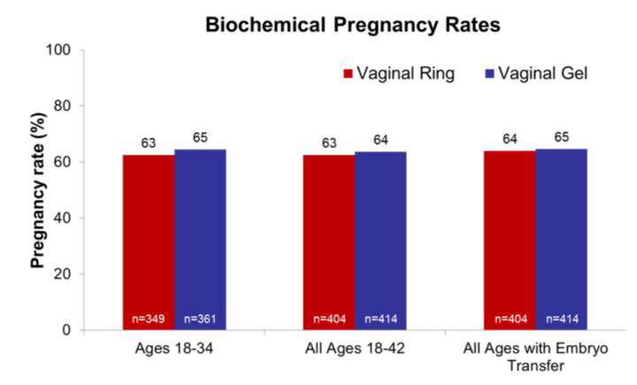
Biochemical pregnancy rates

Slide 39
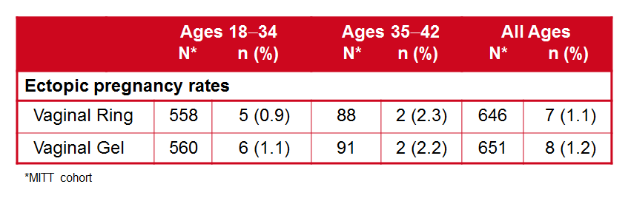
Ectopic pregnancy rates

Slide 40
Key Points for Clinical Pregnancy Rates
Clinical pregnancy rates were comparable between the progesterone vaginal ring and an FDA-approved progesterone vaginal gel.
As would be expected, older women did not have as good of outcomes as younger women.
Spontaneous abortion and ectopic pregnancy rates were low for both treatments and comparable to reported rates.

Slide 41
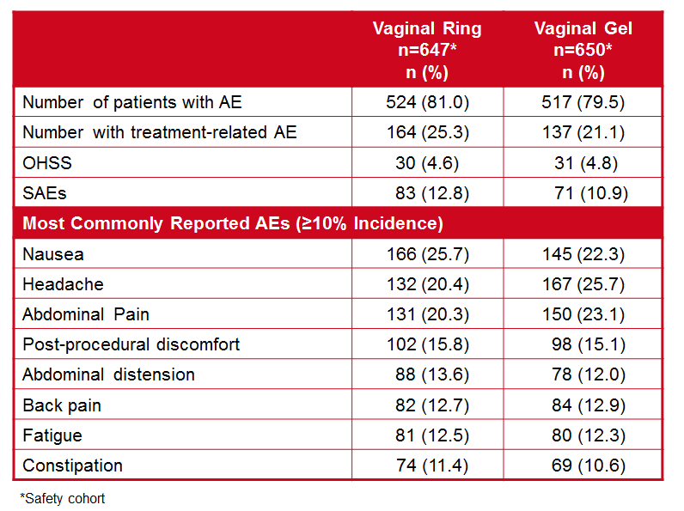
Safety/ Adverse events.

Slide 42
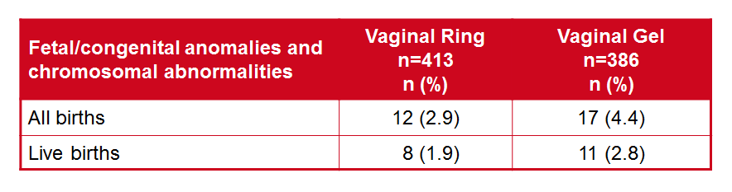
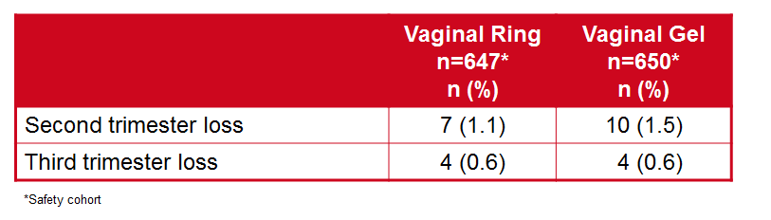
Birth defects.
Second and third trimester loss rates.

Slide 43
Key Points for Safety
Overall, the progesterone vaginal ring appeared to be well-tolerated.
There were similar AEs reported for both treatment groups and there were no significant safety trends noted.
There were no unexpected safety events. The adverse events that were reported were consistent with the known profile of progesterone.

Slide 44
Patient Satisfaction

Slide 45
Subjects who responded “much less” or “less” for her current progesterone medication compared with a previous progesterone medication

Slide 46
Key Points for Patient Satisfaction
Most women in both treatment groups were not worried that they did not use their medication properly or receive the full dose of their medication.
When comparing to previous progesterone use, more women who used the vaginal ring found their current progesterone medication easier to use, less messy, less stressful, and less likely to cause leakage compared to women who used the vaginal gel.
Overall, women in both treatment arms reported their current progesterone medication was more convenient to use than previous progesterone medications

Slide 47

Overall Clinical Data Conclusions
The progesterone vaginal ring prepares the endometrium for pregnancy and supports pregnancy similar to an FDA-approved progesterone vaginal gel.
The progesterone vaginal ring is as safe and efficacious as an FDA-approved progesterone vaginal gel for luteal supplementation in ART.
The vaginal ring may be easier to use than other delivery methods of progesterone based on patient responses and because of its weekly dosing regimen.

